Slide 1

Project Supervisor Group -41
Dr. Jagpreet Sidhu 191455 - SHIVAM VERMA
191377 – JEET DHAMIJA
STOCK MARKET DATA PREDICTION (WEB APP)

Slide 2
Accurate stock market prediction is of great interest to investors; however, stock markets are driven by volatile factors such as microblogs and news that make it hard to predict stock market index based on merely the historical data. The enormous stock market volatility emphasizes the need to effectively assess the role of external factors in stock prediction. Stock markets can be predicted using machine learning algorithms on information contained in social media and financial news, as this data can change investors’ behavior. In this paper, we use algorithms on social media and financial news data to discover the impact of this data on stock market prediction accuracy for ten subsequent days. For improving performance and quality of predictions, feature selection and spam tweets reduction are performed on the data sets.
Abstract

Slide 3
Is it worth to invest in the stock market ?
For long-term investors, the stock market is a good investment no matter what's happening day-to-day or year-to-year; it's that long-term average they're looking for

Slide 4
PROJECT
We are proposing a Stock Market Data Prediction (Web app) for better understanding of stocks using Streamlit python framework for creating web app. SMDP Web app includes prediction of Stocks Data frame, visualization and comparison of actual and predicted data .

Slide 5
Flow of Project
Getting the Stocks data
Visualizing the dataset using
various libraries
Building ML Models
Prediction and comparison against actual data
STREAMLIT PYTHON API

Slide 6

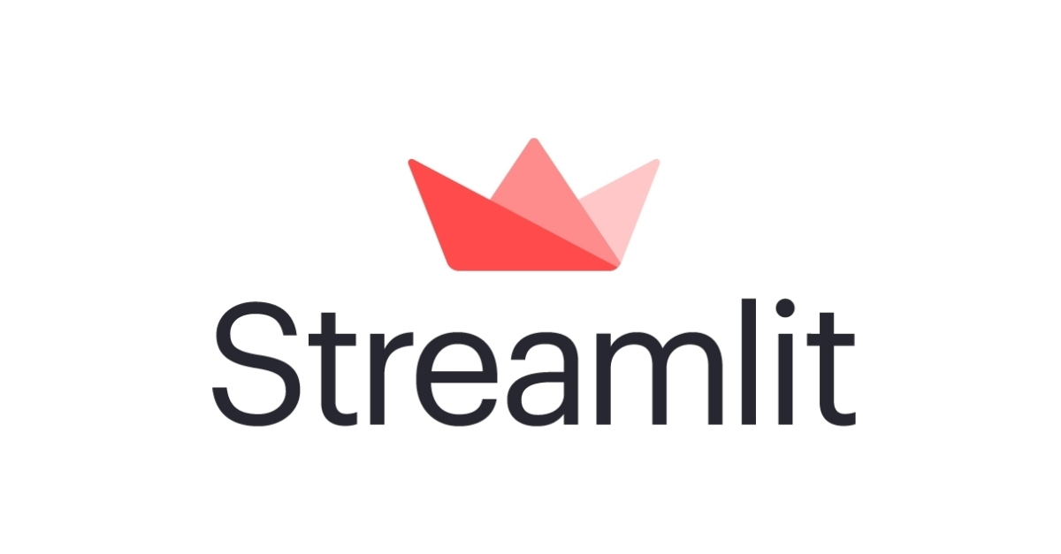
STREAMLIT AND WHY?
Streamlit is an open-source python framework for building web apps for machine learning and data science. We can instantly develop web apps and deploy them easily using streamlit. Streamlit allows you to write an app the same way you write a python code.

Slide 7
Getting the Stocks data
*

Slide 8
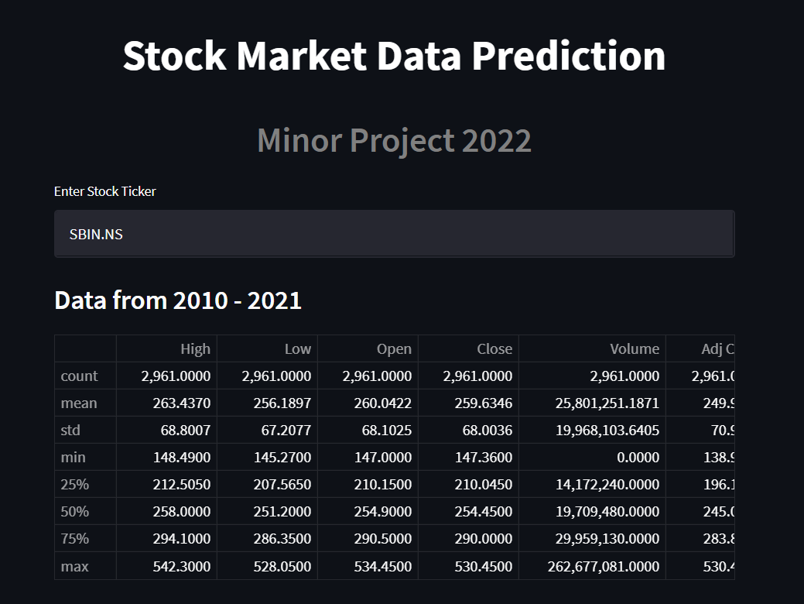
We use python library (Yfinance)

Slide 9
Yfinance python API ?
yfinance is a popular open source library developed by Ran Aroussi as a means to access the financial data available on Yahoo Finance.

Slide 10
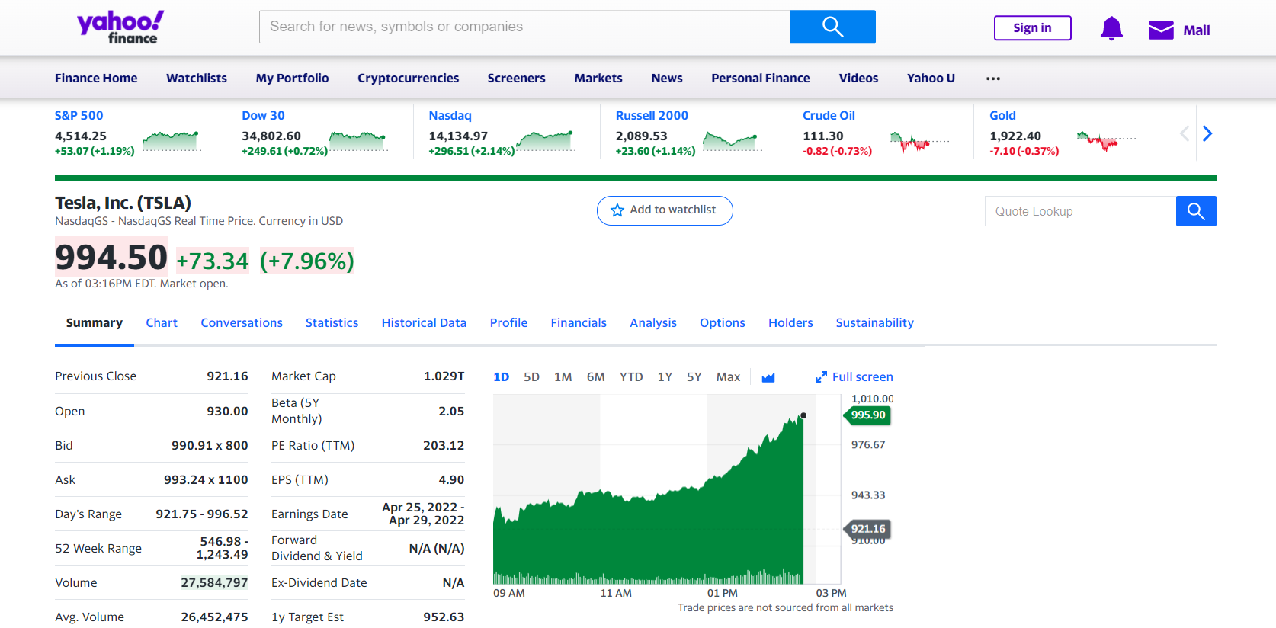
Yfinance web portal

Slide 11
Visualizing the dataset
*

Slide 12
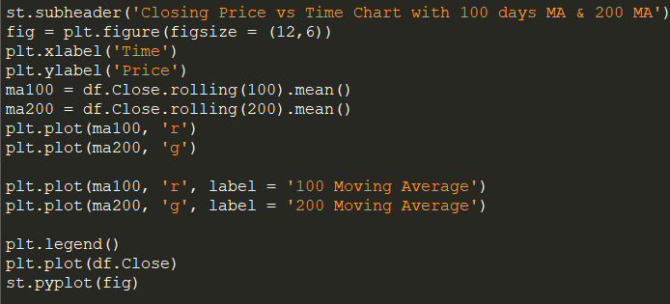
Code for Visualization

Slide 13
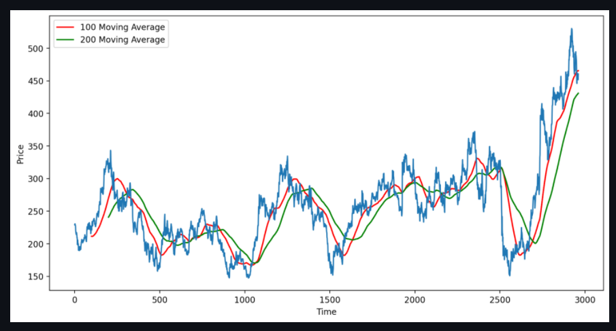
Visualization

Slide 14
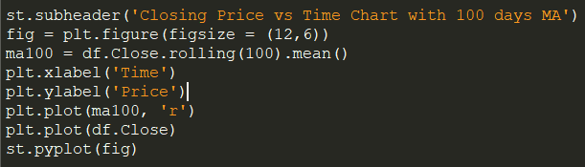
Code for Visualization

Slide 15
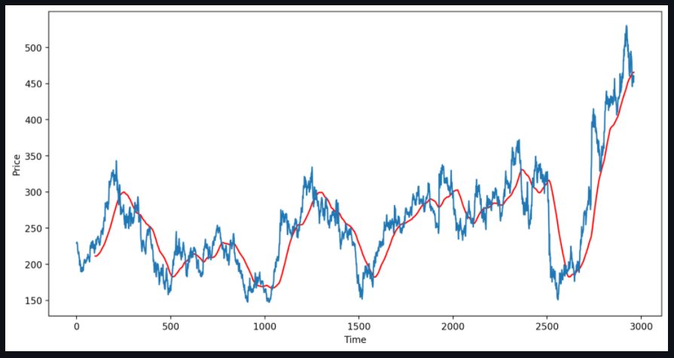
Visualization

Slide 16
FLOW CHART
START
Yahoo Finance Stocks Dataset
Streamlit
API
preprocessing
Applying ML model
Visualization of Dataset
Result and analysis
END

Slide 17

Thank you

